Slide 1








PRESENTATION 2026
PRESENTATION 2026
Crystal Pay: Clean Data, Clear Financial Decisions
Student Name
Mentor Name
Srijoni Gupta
Guide Name: Umamaheshwari
srijoni.gupta@gmail.com

Slide 2

Outline
Abstract of the Project
Problem Statement
Proposed Solution
System Architecture
Live Demo of the Project
Embedded Video of Project
Conclusion
Future Scope

Slide 3
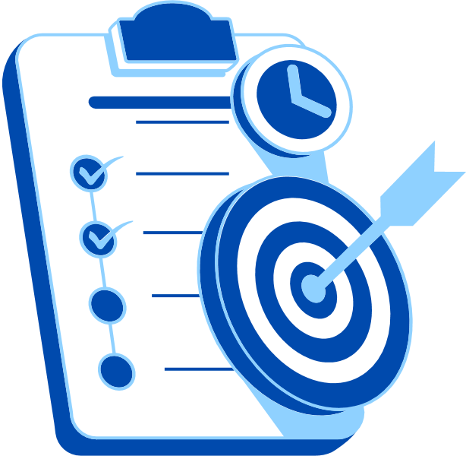
Abstract
Objective: Improve payroll accuracy, transparency, and compliance by validating salary components (basic pay, allowances, overtime, bonuses, deductions) and providing actionable insights.
Tools: Microsoft Excel for data cleaning, Copilot Studio chatbot for interactive payroll queries, and Power BI for dashboards and KPI visualization.
Method:
Clean and standardize payroll dataset (500+ employee records).
Build KPI framework for overtime, bonuses, gross vs. net salary, and department‑wise costs.
Integrate chatbot for anomaly detection and query support.
Visualize insights through interactive Power BI dashboards.

Slide 4

Abstract
Outcome:
Validated payroll dataset with reduced errors.
Transparent dashboards showing department costs, overtime hotspots, and bonus flows.
AI‑assisted workflows that save time and ensure reproducibility.
Stakeholder‑ready reports for HR and Finance decision‑making.

Slide 5

Problem Statement
Payroll Accuracy & Transparency: Crystal Pay’s dataset includes multiple salary components — basic pay, allowances, overtime, bonuses, and deductions. Errors in overtime calculation, bonus allocation, or deduction entries reduce payroll accuracy and compliance.
Departmental Cost Visibility : The dataset spans HR, Finance, IT, and Sales. However, Crystal Pay currently lacks clear insights into department‑wise salary distribution, overtime trends, and bonus flows, limiting workforce cost planning.
Overtime & Bonus Flow Optimization : Employees show wide variation in overtime hours and bonus structures. Without systematic tracking, compensation fairness is compromised, and forecasting payroll liabilities becomes difficult.

Slide 6
Problem Statement
Gross vs. Net Salary Analysis : While gross and net salary values are available, Crystal Pay does not yet provide actionable insights such as identifying top earners, high‑deduction cases, or overtime hotspots that could guide HR and Finance in decision‑making.
Scalability & Compliance Risks: With 500+ records across multiple years, manual analysis is error‑prone. Lack of automated anomaly detection and standardized reporting increases compliance risks and reduces efficiency.

Slide 7
Problem Statement
Decision Support Gaps: Crystal Pay’s current payroll system does not leverage predictive analytics to forecast salary liabilities, overtime costs, or bonus distributions, leaving HR and Finance without proactive decision‑support tools.
Workforce Planning & Strategic Insights: Beyond payroll totals, Crystal Pay lacks dashboards that highlight workforce trends such as overtime hotspots, bonus fairness, and department‑wise salary efficiency limiting HR and Finance in making strategic decisions.

Slide 8

Proposed Solution
Payroll Data Validation – Clean Data, Confident Decisions : Automate duplicate removal, overtime calculation checks, and deduction consistency using Excel and Copilot Studio. This ensures payroll accuracy and compliance across 500+ records.
Department‑Wise Segmentation – Clear Workforce Insights: Use Power BI dashboards to break down HR, Finance, IT, and Sales salary structures. Provide department‑specific views of overtime, bonuses, and net salary trends for strategic planning.
Overtime & Bonus Analytics – Fair Pay, Transparent Flows : Develop dashboards that highlight overtime hotspots and bonus allocation fairness. Visualize their impact on gross and net salaries to support HR and Finance in policy optimization.

Slide 9

Proposed Solution
Top Earners & Deduction KPIs – Actionable Decision Support : Generate KPI charts that identify top earners, employees with high deductions, and unusual salary variations. These insights guide payroll adjustments and compliance checks.
Predictive Payroll Forecasting – Smarter Budgeting Ahead: Leverage historical payroll data to forecast salary liabilities, overtime costs, and bonus distributions. Predictive analytics help HR and Finance plan budgets proactively.
Scalable Reporting – Stakeholder‑Ready Dashboards : Integrate Excel, Power BI, and Copilot Studio to deliver interactive dashboards and compliance‑ready reports. Outputs are reproducible, transparent, and scalable for future expansion.

Slide 10
System Architecture
Data Input / Source
Processing / Analysis
Payroll dataset with 500+ employee records (basic pay, allowances, overtime, bonuses, deductions, gross & net salary).
Imported and cleaned in Microsoft Excel for consistency and accuracy.
Data cleaning: duplicate removal, salary validation, department standardization.
KPI preparation: overtime trends, bonus flows, gross vs. net salary comparisons.
Excel used for preprocessing and structured dataset creation.
AI / Tool Integration
Output / Dashboard
Copilot Studio chatbot designed to answer payroll queries (e.g., overtime, bonuses, department costs).
AI workflows for anomaly detection, automated reporting, and stakeholder‑ready explanations.
Integration ensures reproducibility and interactive query handling.
Power BI dashboards for visualization:
Department‑wise salary distribution
Overtime & bonus analytics
Top earners and deduction insights
Interactive KPI charts and compliance‑ready reports for HR and Finance decision‑making.

Slide 11
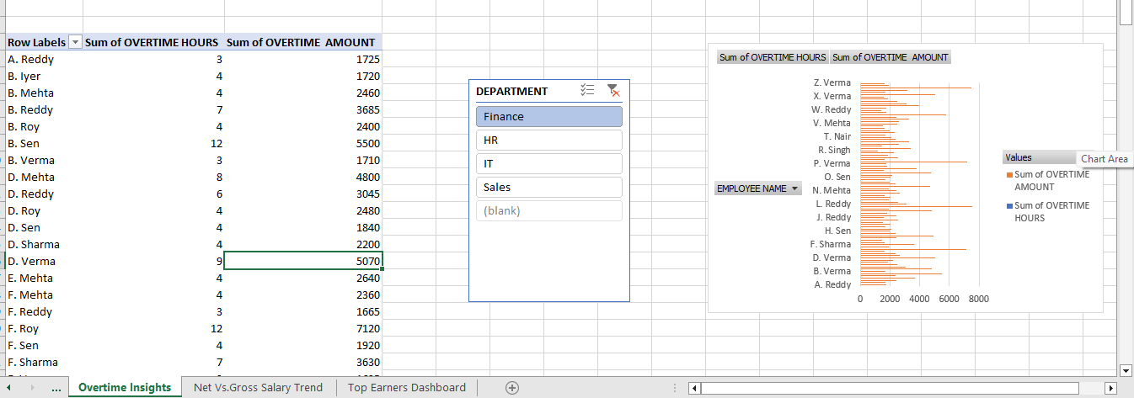
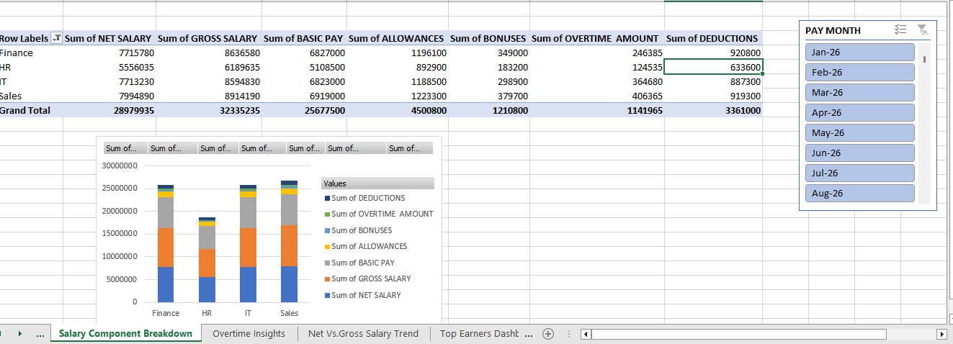
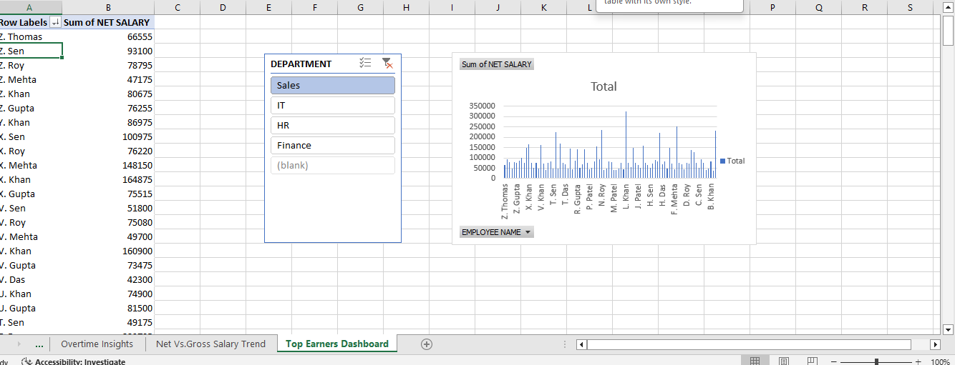
Live Demo of Project
Here's the list of some demo screenshots / features of the project:
Demo 1
Demo 2
Demo 3
Overtime Insights
Salary Component Breakdown
Top Earners Dashboard

Slide 12
Video of Project Demo
https://drive.google.com/drive/folders/1cLfXVnzroVGITwH7DL3bzR9n97L4IDyP
▶
[Insert your project demo video.
You can embed a video your live project.]

Slide 13

Conclusion
Data cleaning improved payroll accuracy and compliance.
Dashboards provided transparency into workforce costs.
AI-assisted workflows saved time and ensured reproducibility.
Objectives achieved: validated dataset, KPI framework, actionable insights.
CONCLUSION

Slide 14

Future Scope
Integration with real-time payroll systems.
Expansion into predictive analytics (spending demand, churn prediction).
Enhanced personalization via customer segmentation.
Scalability with Power BI and advanced AI models.

Slide 15
Thank You
AICW Fellowship | Student Project Presentation 2026
LinkedIn | Edunet Foundation

